Slide 1
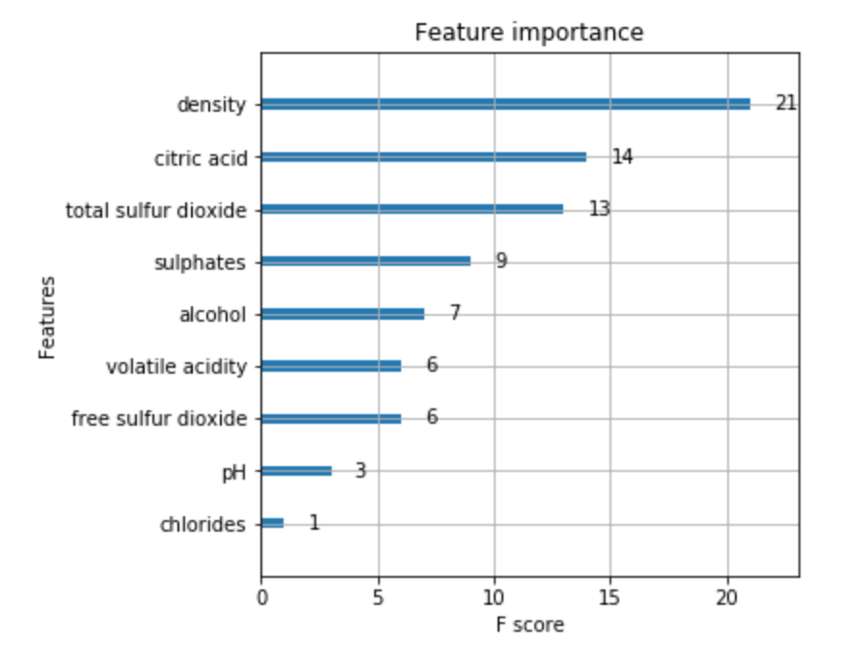


Feature Importance
Low quality
Airy
Low alcohol
High quality
Dense
Sharp acidity
Significance to Portugal
Dietary
Geographic
Historical

Slide 2
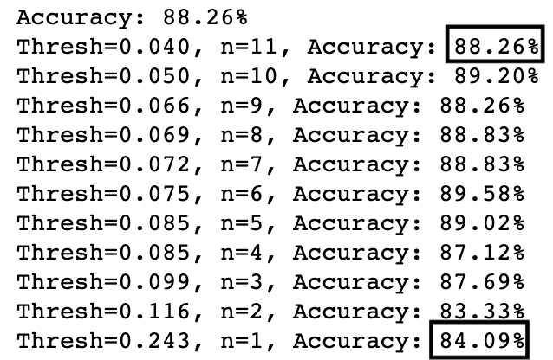
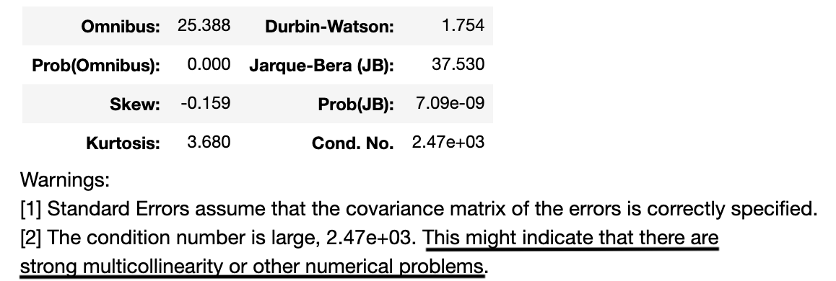
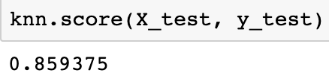
Feature Importance
Predictive application
Adequate forecasting with small number of features
Suggests high correlation between independent variables

